Slide 1
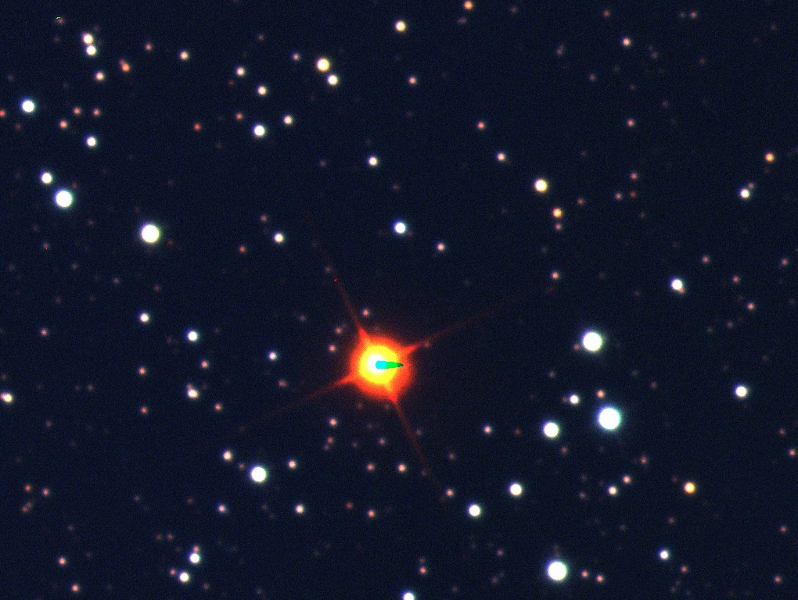
LW Cygni

Slide 2
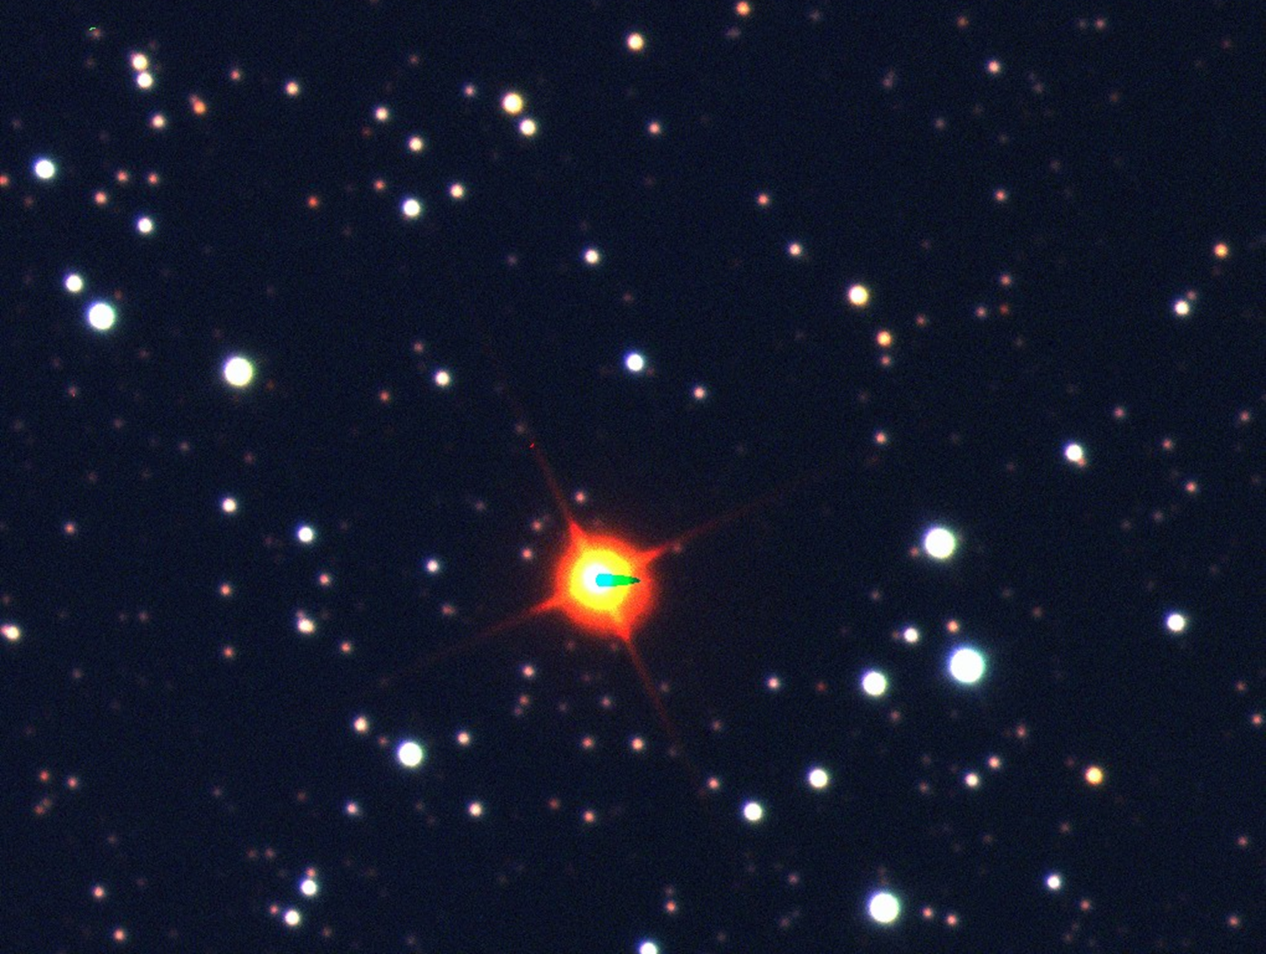
LW Cygni
This is a red slowly varying irregular variable carbon-star giant in the constellation Cygnus. It’s variable period is unknown. It is an optical double star.
It is visible to the naked eye.

Slide 3
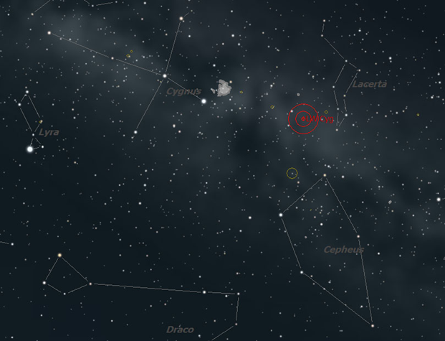
LW Cygni

Slide 4
LW Cygni
Size: Unknown
B-V Color Index: +4.10, red
Luminosity: Unknown

Slide 5
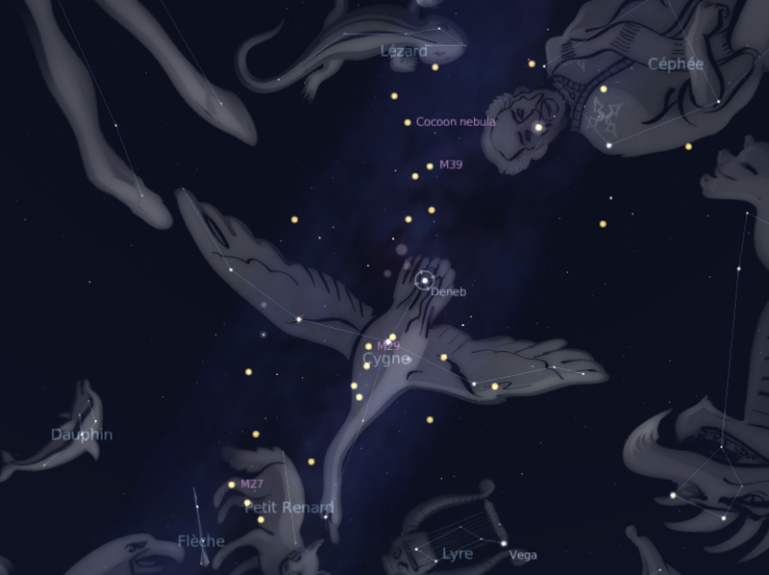
LW Cygni
Cygnus Constellation

Slide 6
LW Cygni
    Distance: 16,000 light years
    Temperature: Unknown, but cool
    Mass: Unknown
    Magnitude Range: +12.3 to +14.5

Slide 7
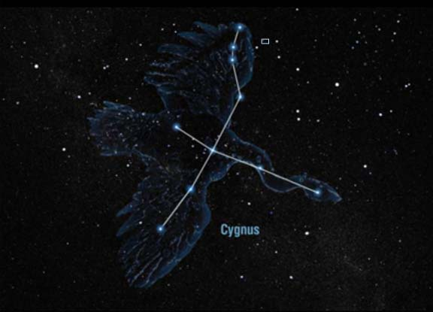
LW Cygni

Slide 8

Carbon Star Basics
As sun-like stars age, their core compresses and heats up and basically cooks the helium nuclei into carbon. The convective currents in the star’s atmosphere move the carbon from the core to the outer layers where they form a fine soot. The soot scatters away blue and green light, so only the red and orange wavelengths penetrate the carbon dust to reach our eyes.

Slide 9
Carbon Star Basics
• Sunsets are red for similar reasons to carbon stars. At the horizon, sunlight travels through more atmosphere, scattering away the blues and greens, leaving the red for our eyes.
• All carbon stars are variable and vary in brightness over the course of months or even more than a year.

Slide 10


Slide 11


Carbon Star Basics

Slide 12

Carbon Star Basics
Carbon stars vary in color. What color do you see in the telescope?

